Slide 2
Pivotal CF
Ops Manager and BOSH deep dive
Comments about this deck: fmelo@pivotal.io

Slide 3
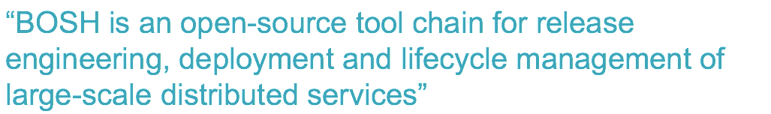
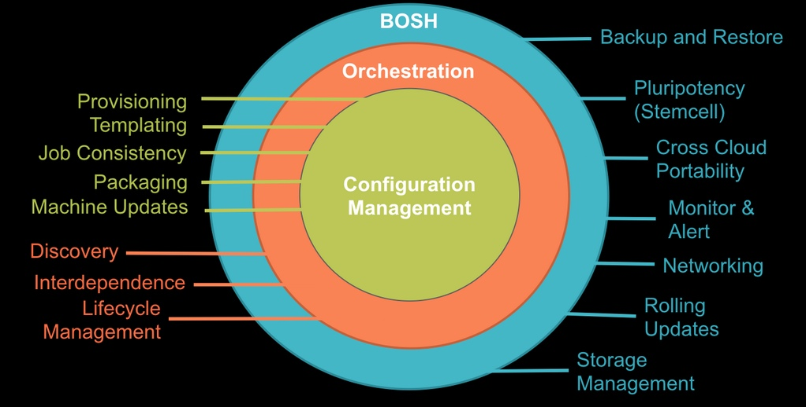

Slide 4
Why BOSH
Provision services, not machines
Enables continuous delivery
Cloud-agnostic view of Platform Ops
Holistic Toolchain for “rule them all"
Eliminate bespoke automation on top of config management

Slide 5
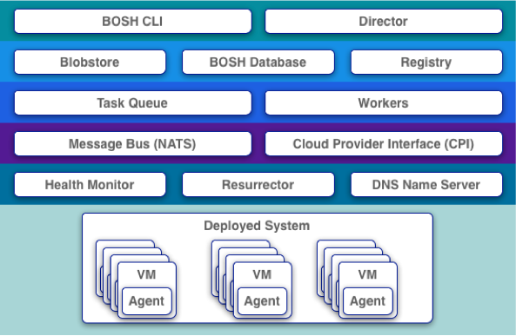
The BOSH Architecture
Very similar to CF architecture itself
Director as analogy to Cloud Controller
Different CPIs exist per IaaS implementation
Workers responsible for executing tasks as dictated by Director

Slide 6
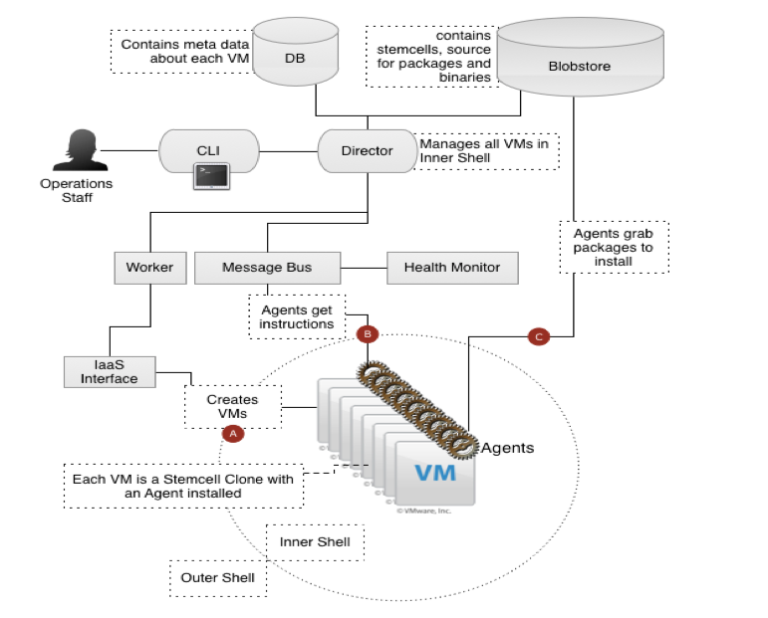
The BOSH Architecture
Very similar to CF architecture itself
Director as analogy to Cloud Controller
Different CPIs exist per IaaS implementation
Workers responsible for executing tasks as dictated by Director

Slide 7

Three main components of a bosh deployment
Manifest
Stemcell
Release
Agent

Slide 8



BOSH deployment
DB
BOSH
Upload Stemcell
BOSH CLI
BOSH Director
Blobstore
NATS
Health
Monitor

Slide 9
BOSH deployment
DB
BOSH
Upload Release
BOSH CLI
BOSH Director
Blobstore
NATS
Health
Monitor

Slide 10
BOSH deployment
DB
BOSH
Set Manifest
BOSH CLI
BOSH Director
Blobstore
NATS
Health
Monitor

Slide 11

BOSH deployment
IaaS
DB
BOSH
Deploy
BOSH CLI
BOSH Director
Worker VMs
Blobstore
NATS
Target VM
Target VM
Health
Monitor
Target VM
BOSH agent

Slide 12
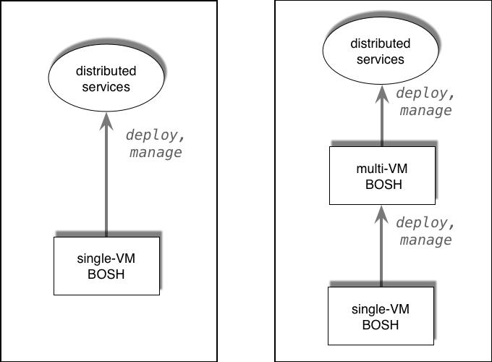
BOSH possible flows
http://docs.cloudfoundry.org/bosh/workflow.html

Slide 13


How about and CF?

Slide 14


















CloudBees Jenkins
Enterprise
Cassandra
for Pivotal CF
ElasticSearch
for Pivotal CF
Mobile Services
for Pivotal CF
BOSH Director
BOSH Agent
IaaS

Slide 15
Click to install
No downtime updates
Explore install logs
Click to scale the platform
CloudBees Jenkins
Enterprise
Built-in High Availability
Cassandra
for Pivotal CF
Built-in Platform Monitoring
ElasticSearch
for Pivotal CF
Mobile Services
for Pivotal CF
BOSH Director
BOSH Agent
Integrated services
IaaS

Slide 16


CF
BOSH releases
CloudBees Jenkins
Enterprise
Cassandra
for Pivotal CF
ElasticSearch
for Pivotal CF
Mobile Services
for Pivotal CF
BOSH Director
BOSH Agent
IaaS

Slide 17

BOSH possible flows
Pivotal CF flow
Bootstrap
+
Manage Releases
Manage Config
Bosh Client
http://docs.cloudfoundry.org/bosh/workflow.html

Slide 18
How does a Pivotal CF install work?

Slide 19
Pivotal CF flow
Deploy Ops Manager VM

Slide 20


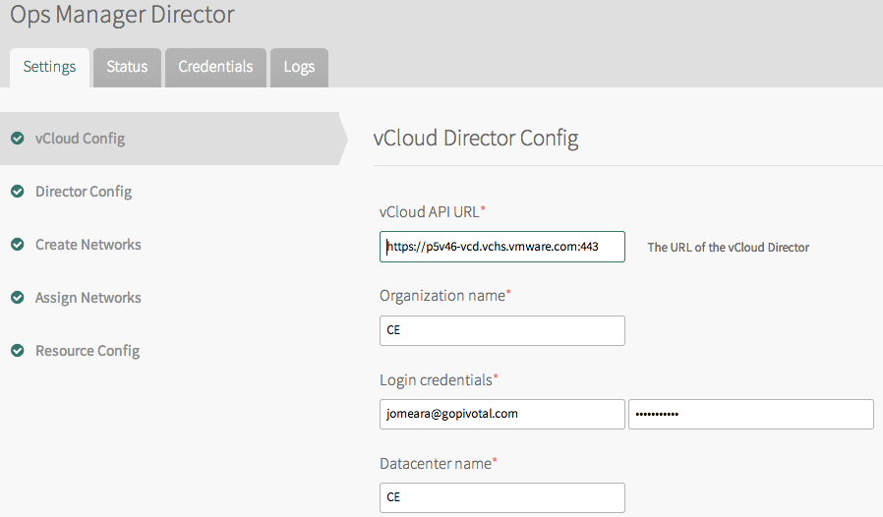


Deploy Ops Manager VM
Conf. IaaS tile / apply changes
Manifest
BOSH Bootstrap

Slide 21
Deploy Ops Manager VM
Ops Manager Director
MicroBOSH
Conf. IaaS tile / apply changes
Manifest
BOSH Bootstrap

Slide 22

Deploy Ops Manager VM
Ops Manager Director
MicroBOSH
Conf. IaaS tile / apply changes
CF Release
Add ER tile (BOSH release)

Slide 23


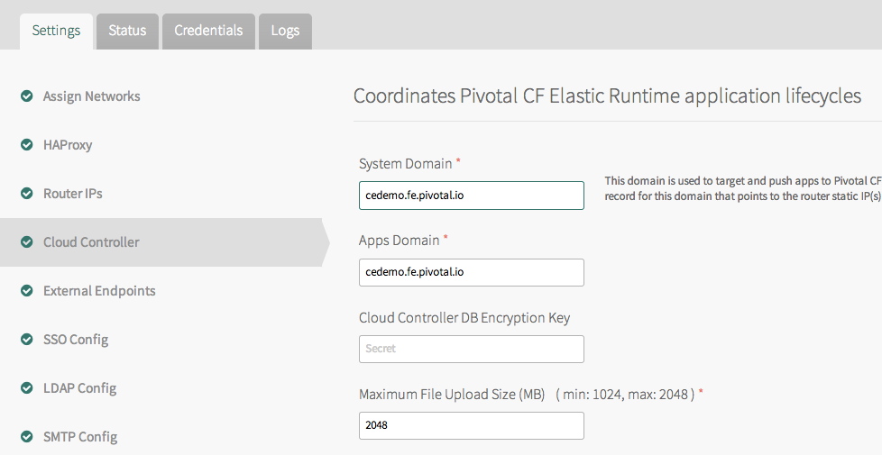
Deploy Ops Manager VM
Ops Manager Director
MicroBOSH
Conf. IaaS tile / apply changes
CF Release
CF Release
Manifest
Add ER tile (BOSH release)
Config parameters

Slide 24

Deploy Ops Manager VM
Ops Manager Director
MicroBOSH
Conf. IaaS tile / apply changes
CF Release
Manifest
Add ER tile (BOSH release)
Apply Changes
Upload Release + Stemcell

Slide 25
Deploy Ops Manager VM
Ops Manager Director
MicroBOSH
Conf. IaaS tile / apply changes
CF Release
Manifest
Add ER tile (BOSH release)
Apply Changes
Set Manifest

Slide 26
Deploy Ops Manager VM
Ops Manager Director
MicroBOSH
Conf. IaaS tile / apply changes
CF Release
Add ER tile (BOSH release)
Apply Changes
Deploy

Slide 27
Ops Manager Director
Deploy Ops Manager VM
Ops Manager Director
MicroBOSH
Conf. IaaS tile / apply changes
CF Release
Add ER tile (BOSH release)
Blobstore
DB
Apply Changes
Cloud Controller
BOSH Director
NATS
Health Manager
BOSH Agent
DEA
BOSH Agent
BOSH Agent
BOSH Agent
NATS
Worker VMs
Health Monitor
MicroBOSH
vSphere

Slide 28
Deploy Ops Manager VM
Ops Manager Director
MicroBOSH
Conf. IaaS tile / apply changes
CF Release
Add ER tile (BOSH release)
Blobstore
DB
Apply Changes
Cloud Controller
BOSH Director
NATS
Health Manager
BOSH Agent
DEA
Ping
BOSH Agent
BOSH Agent
BOSH Agent
NATS
Worker VMs
Elastic Runtime
Health Monitor
MicroBOSH

Slide 29

Deploy Ops Manager VM
Ops Manager Director
MicroBOSH
Conf. IaaS tile / apply changes
CF Release
Add ER tile (BOSH release)
Apply Changes
(… same for other services)

Slide 30


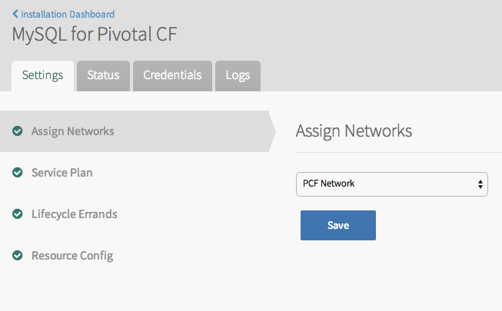
Deploy Ops Manager VM
Ops Manager Director
MicroBOSH
Conf. IaaS tile / apply changes
CF Release
Manifest
Add ER tile (BOSH release)
Apply Changes
(… same for other services)

Slide 31
Deploy Ops Manager VM
Ops Manager Director
MicroBOSH
Conf. IaaS tile / apply changes
CF Release
Manifest
Add ER tile (BOSH release)
Apply Changes
Upload Release + Stemcell
(… same for other services)

Slide 32
Deploy Ops Manager VM
Ops Manager Director
MicroBOSH
Conf. IaaS tile / apply changes
CF Release
MySQL Release
Manifest
Add ER tile (BOSH release)
Apply Changes
Set Manifest
(… same for other services)

Slide 33
Deploy Ops Manager VM
Ops Manager Director
MicroBOSH
Conf. IaaS tile / apply changes
CF Release
MySQL Release
Add ER tile (BOSH release)
Apply Changes
Deploy
(… same for other services)

Slide 34
Ops Manager Director
Deploy Ops Manager VM
Ops Manager Director
MicroBOSH
Conf. IaaS tile / apply changes
CF Release
MySQL Release
Add ER tile (BOSH release)
Blobstore
DB
Apply Changes
MySQL Server
BOSH Director
Service Broker
BOSH Agent
(… same for other services)
MySQL Server
BOSH Agent
BOSH Agent
NATS
Worker VMs
Health Monitor
MicroBOSH
vSphere

Slide 35
Deploy Ops Manager VM
Ops Manager Director
MicroBOSH
Conf. IaaS tile / apply changes
CF Release
MySQL Release
Add ER tile (BOSH release)
Blobstore
DB
Apply Changes
MySQL Server
BOSH Director
Service Broker
BOSH Agent
(… same for other services)
MySQL Server
Ping
BOSH Agent
BOSH Agent
NATS
Worker VMs
Pivotal MySQL
Health Monitor
MicroBOSH

Slide 36
Deploy Ops Manager VM
Ops Manager Director
MicroBOSH
Conf. IaaS tile / apply changes
CF Release
MySQL Release
Add ER tile (BOSH release)
BOSH Director
Apply Changes
NATS
Health Monitor
(… same for other services)
Ping
Ping
MySQL Server
Cloud Controller
Service Broker
NATS
Health Manager
BOSH Agent
BOSH Agent
MySQL Server
DEA
BOSH Agent
BOSH Agent
BOSH Agent
BOSH Agent
BOSH Agent
Pivotal MySQL
Elastic Runtime

Slide 37
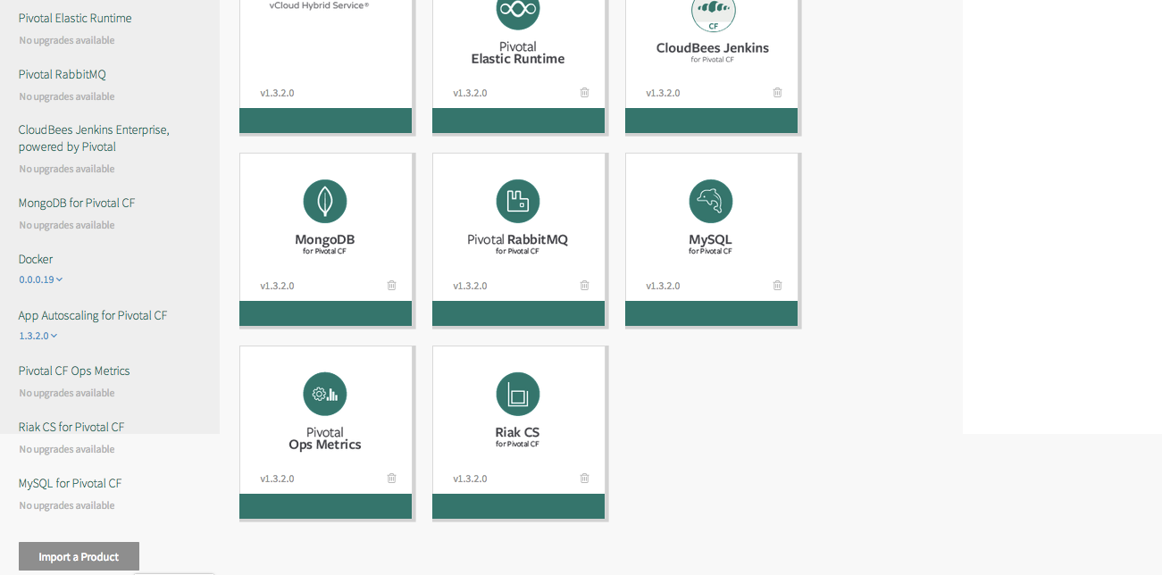


… adding a new tile
Upload a .pivotal file
p-rabbitmq-1.3.pivotal

Slide 38
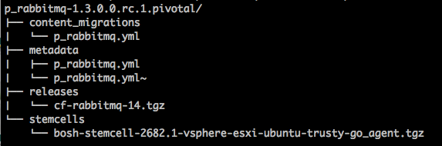
What’s inside a .pivotal file?
Ops Manager tile file
p-rabbitmq-1.3.pivotal
Migration from previous versions
Manifest template (includes tile image)
BOSH release
Stemcell

Slide 39
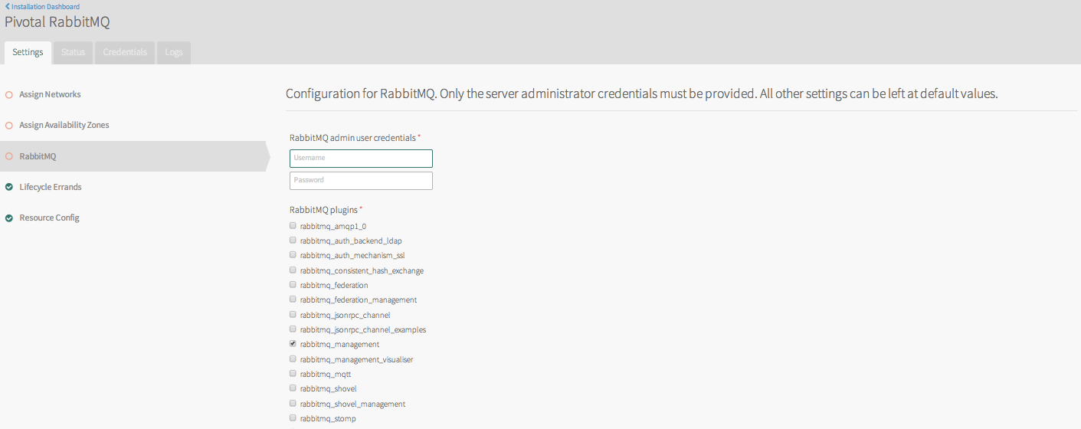
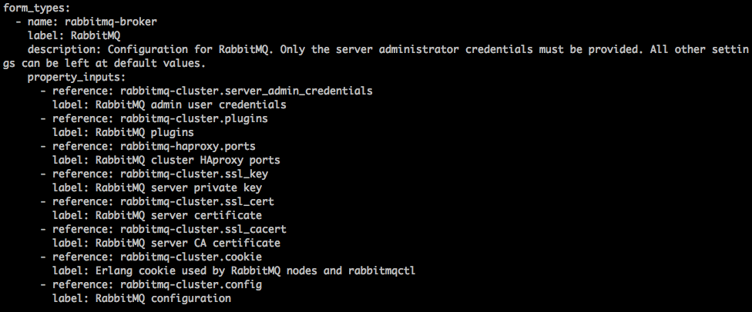
What’s inside a .pivotal file?
Ops Manager tile file
Manifest

Slide 40
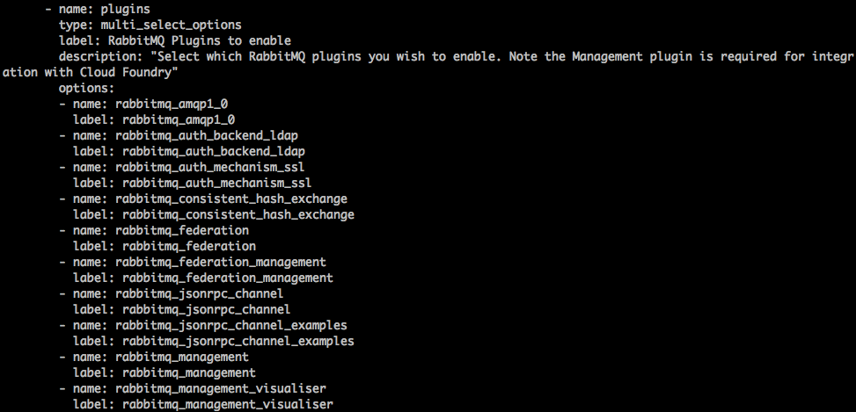
What’s inside a .pivotal file?
Ops Manager tile file
Manifest

Slide 41
Three main components of a bosh deployment
Manifest
Deployment Descriptor
Stemcell
Release
Agent
VM / Container template + Agent

Slide 42

… so what exactly is a BOSH release?
Release

Slide 43

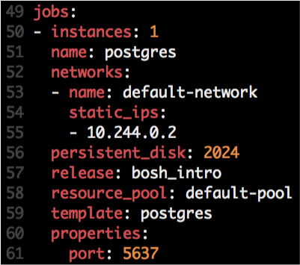



Anatomy of BOSH releases
http://docs.cloudfoundry.org/bosh/create-release.html
Release
Job
Job
Stemcell
OS Process
Monit script
OS Process
OS Process
Instantiated in runtime based on
Agent
Monit
Monit
Manifest
Monit
Example of Jobs:
DEA (CF)
CloudController (CF)
Service Broker (MySQL & Rabbit)
Locator (possible GemFire release)
Depends
src
Scripts:
Depends
Packaging
Packages
Pre-Packaging
Depends
Blobs
Depends

Slide 44

Job Creation
Deployment
Job
Stemcell
VM / Container
VM / Container
OS Process
BOSH Director
Ping
Agent
Monit
Agent
Agent
NATS
Job
Job
Ping
Health Monitor
OS Process
Monit
Compiled Packages

Slide 45

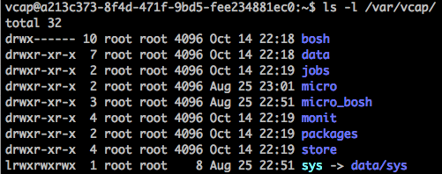
Logs
Deployment
Job
VM / Container
Stemcell
OS Process
BOSH Director
Agent
Ping
Monit
Log: /var/vcap/monit/monit.log
NATS
Job
Agent
Logs: /var/vcap/sys/logs/<job>
Health Monitor
Logs: /var/vcap/sys/logs/hm9000*.log
Compiled Packages

Slide 46
How do BOSH-based updates work?
once deployments are there …

Slide 47

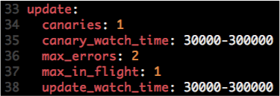
Canary Deployments
Manifest

Slide 48
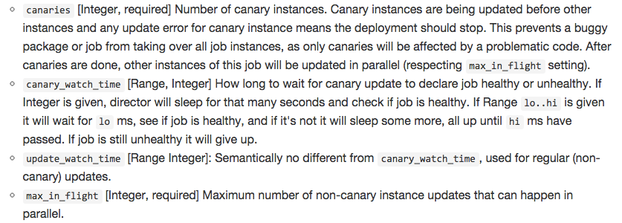
How do canary deployments work
Manifest

Slide 49
How do canary deployments work
Manifest
No downtime, atomic rolling update

Slide 50


How do canary deployments work
Example:
# of Canaries: 2
Max in Flight: 2
Canaries
v1.0
v1.1

Slide 51

How do canary deployments work
Example:
# of Canaries: 2
Max in Flight: 2
Once failed, Canary VMs are kept for troubleshooting purposes.
v1.1
v1.2

Slide 52
How do canary deployments work
Example:
# of Canaries: 2
Max in Flight: 2
Once failed, Canary VMs are kept for troubleshooting purposes.
v1.1
v1.2

Slide 53
Review:
BOSH and High Availability

Slide 54

4 Layers of built-in High Availability
Application Instance
Platform Processes
Platform VMs
Availability Zones

Slide 55
4 Layers of built-in High Availability
Application Instance
Platform Processes
Platform VMs
Availability Zones

Slide 56
App Instance HA
Blobstore
Cloud Controller
Actual State
Messaging (NATS)
Health Manager
Router
DEA
DEA
DEA
Cloud Foundry
Runtime

Slide 57
4 Layers of built-in High Availability
Application Instance
Platform Processes
Platform VMs
Availability Zones

Slide 58

Platform Processes HA
BOSH
Pivotal CF
DB
DEA
Agent
Process
BOSH Director
Health Manager
Blobstore
Process
Agent
Messaging
NATS
Agent
Process
Health
Monitor
Cloud Controller
Target VM
Agent
Process

Slide 59

Platform Processes HA
Target VM
Cloud Controller
Agent
Process
Restart

Slide 60
4 Layers of built-in High Availability
Application Instance
Platform Processes
Platform VMs
Availability Zones

Slide 61
Platform VMs HA
BOSH
Pivotal CF
DB
Cloud Controller
Agent
Process
BOSH Director
Re-create VM
Health Manager
Blobstore
Process
Agent
Ressurector
VM is
missing…
Messaging
NATS
Agent
Process
Health
Monitor
Cloud Controller
Agent
Process

Slide 62
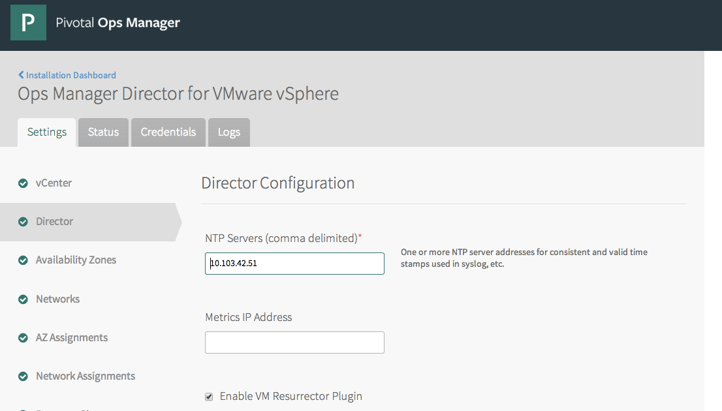


Slide 63
4 Layers of built-in High Availability
Application Instance
Platform Processes
Platform VMs
Availability Zones

Slide 64
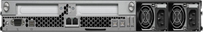
Availability Zones
Availability Zone #1
Availability Zone #2
Blobstore
DEA
Push app
DEA
Cloud Controller
DEA
Router
Messaging (NATS)
DEA
Health Manager
DEA

Slide 65
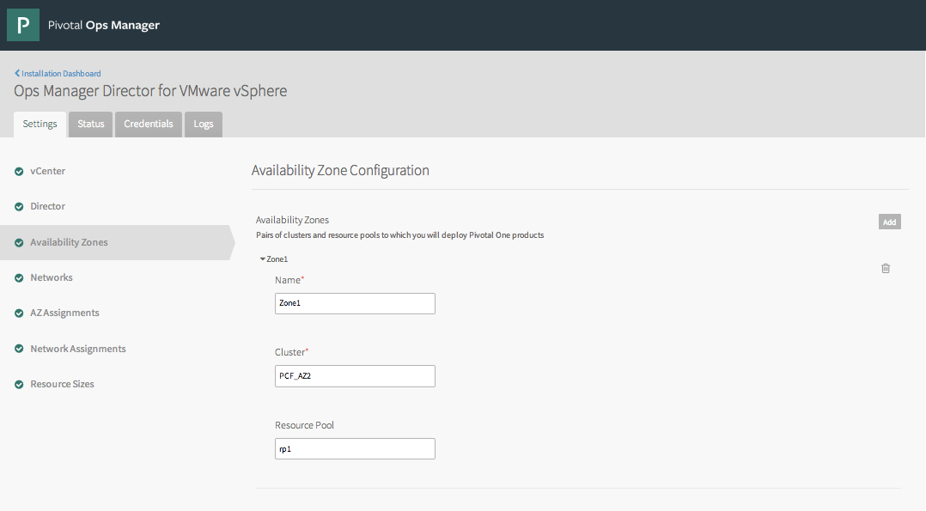
Availability Zones

